Slide 1
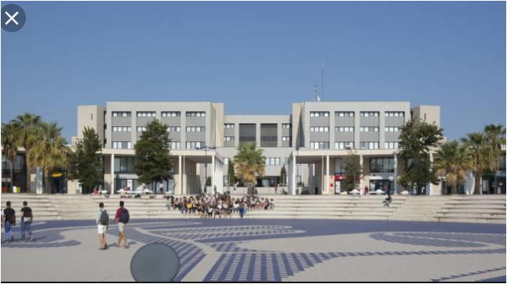
Voor aanzicht

Slide 2
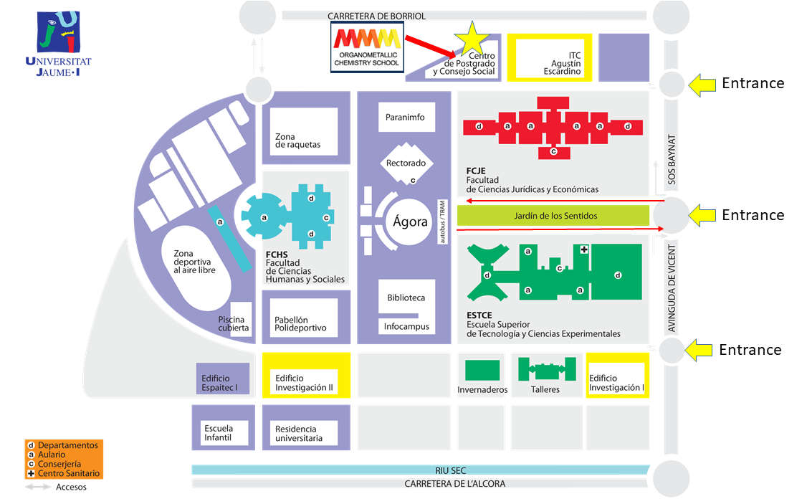
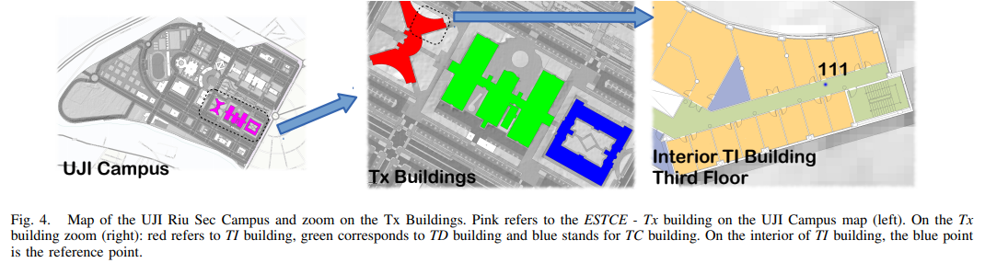

Slide 3
Goal
Test the accuracy (kappa.. of localization algorithms on RSSI levels or for
Performing a comparison of localization algorithms under the same experimental framework
Or f.e.
How the internal structure of the building is related with the WLAN access points and, therefore, how the number and position of these points can be optimised without being out of WIFI range. Why? for hardware reduction and installation efforts or to reduce the redundant access points keeping a complete coverage.
Detection of low coverage places to optimize data and internet coverage

Slide 4
Data summary
The data covers three buildings with 4 or more floors and almost 110.000m2. It can be used for classification, e.g. actual building and floor identification, or regression, e.g. actual longitude and latitude estimation. It was created in 2013 by means of more than 20 different users and 25 Android devices. The database consists of 19937 training/reference records (trainingData.csv file) and 1111 validation/test records (validationData.csv file). The 529 attributes contain the WiFi fingerprint, the coordinates where it was taken, and other useful information. Each WiFi fingerprint can be characterized by the detected Wireless Access Points (WAPs) and the corresponding Received Signal Strength Intensity (RSSI). The intensity values are represented as negative integer values ranging -104dBm (extremely poor signal) to 0dbM. The positive value 100 is used to denote when a WAP was not detected. During the database creation, 520 different WAPs were detected. Thus, the WiFi fingerprint is composed by 520 intensity values. Then the coordinates (latitude, longitude, floor) and Building ID are provided as the attributes to be predicted. Additional information has been provided. The particular space (offices, labs, etc.) and the relative position (inside/outside the space) where the capture was taken have been recorded. Outside means that the capture was taken in front of the door of the space. Information about who (user), how (android device & version) and when (timestamp) WiFi capture was taken is also recorded.

Slide 5
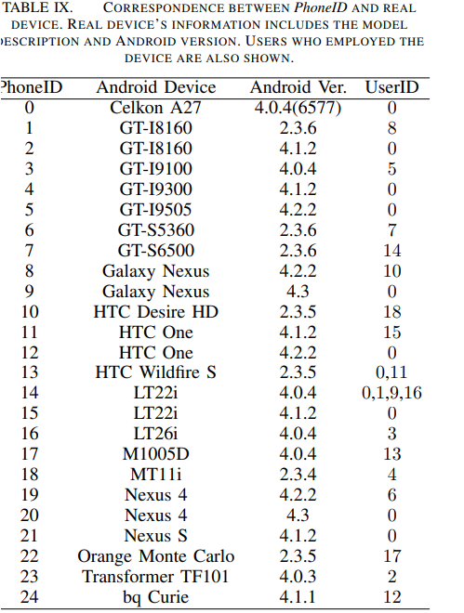
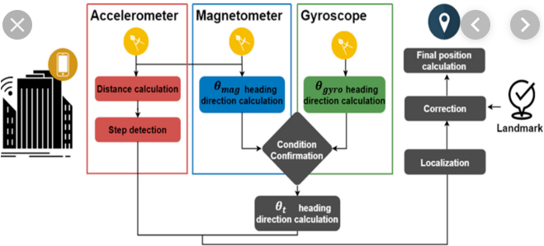
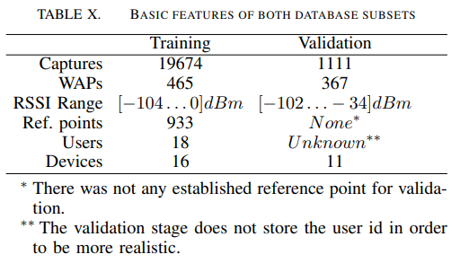
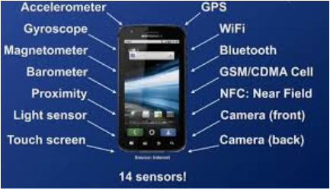
Data collected by 18 users & 20 (25) Android devices

Slide 6
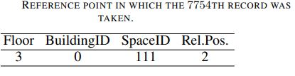
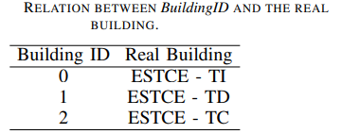

21049 records = single record with 529 numeric elements
18 users, 20 (25 –Android) devices
19.937 training records
1.111 test records (525 & 526 & 527 empty with default value 0 in both fields and to simulate real localization system)
529 attributes, integer/real
933 reference points (places)
Infrastructure less approach by WAP’s
WLAN access points
-45dBm to 0dBm is insignificant and cover only 1.7% of total RSSI levels
-95dBm is also insignificant (2.3% of total RSSI measures)
Building 0 | Building 1 | Building 2
Floor 1, space id 111, Rel. Pos. 2 | Floor 1 space id 111, Rel. Pos. 2 | Floor 2.1 space id 111, Rel. Pos. 2
Floor 2… | Floor 2… | Floor 2…
Floor 3… | Floor 3… | Floor 3…
Floor 4… | Floor 4… | Floor 4…
Regression
Predicting attributes for estimating position of user
Fingerprint
Space id like office, corridor, classroom
WAP 001-519 (RSSI levels) | WAP520 (RSSI - intensity values | 521 (Neg. real- Longitude | 522 (Pos. real- Latitude | 523 (Integer value Altitude Floor 0-4) | 524 (cat. Integer) Building id | 525 space Id (cat. integer) | 526 Relative position for the space (cat. Integer) | 527 User id. Cat. Integer | 528 Phone ID. Android ID Cat. integer | 529 Time stamp Integer value
-104. – 0 (= poor – extremely good) | -104. – 0 (= poor – extremely good) | -7695.9387549299299000 | 4864745.7450159714 | Altitude in floors Inside the building | 0 - 2 | Office, Corridor, Classroom | 1 – inside space, 2 – outside space in front of the door of the space (corridor) | 0 USER0000 (Validation user – N/A) ID USER HEIGHT 1 USER0001 170 2 USER0002 176 3 USER0003 172 4 USER0004 174 5 USER0005 184 6 USER0006 180 7 USER0007 160 8 USER0008 176 9 USER0009 177 10 USER0010 186 11 USER0011 176 12 USER0012 158 13 USER0013 174 14 USER0014 173 15 USER0015 174 16 USER0016 171 17 USER0017 166 18 USER0018 162 | 0 Celkon A27 4.0.4(6577) 0 1 GT-I8160 2.3.6 8 2 GT-I8160 4.1.2 0 3 GT-I9100 4.0.4 5 4 GT-I9300 4.1.2 0 5 GT-I9505 4.2.2 0 6 GT-S5360 2.3.6 7 7 GT-S6500 2.3.6 14 8 Galaxy Nexus 4.2.2 10 9 Galaxy Nexus 4.3 0 10 HTC Desire HD 2.3.5 18 11 HTC One 4.1.2 15 12 HTC One 4.2.2 0 13 HTC Wildfire S 2.3.5 0,11 14 LT22i 4.0.4 0,1,9,16 15 LT22i 4.1.2 0 16 LT26i 4.0.4 3 17 M1005D 4.0.4 13 18 MT11i 2.3.4 4 19 Nexus 4 4.2.2 6 20 Nexus 4 4.3 0 21 Nexus S 4.1.2 0 22 Orange Monte Carlo 2.3.5 17 23 Transformer TF101 4.0.3 2 24 bq Curie 4.1.1 12 | 12:02:22 PM GMT +02
+100 (not detected) | +100 (not detected) | to | to | 0 - 4
+100 = artificial value | +100 = artificial value | -7299.786516730871000 | 4865017.3646842018 |  |  |  |  |  |  | UNIX Time
Real world coordinates

Slide 7
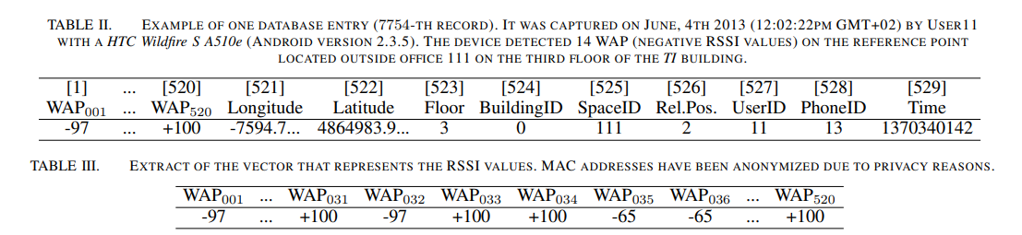
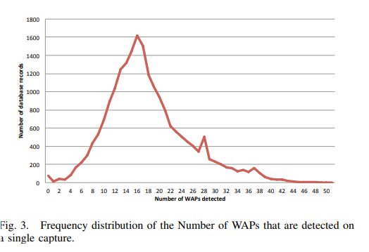
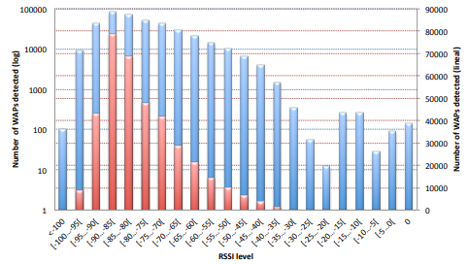
Example of 7754 th record (table II)
1
2
3
4
5
6
7
8
9
10
11
12
13
14
In average 8-25 WAP’s are detected on a single capture
and differs depending on environment and on device

Slide 8
Summary (Workfile[,521:529])
LONGITUDE LATITUDE FLOOR BUILDINGID SPACEID RELATIVEPOSITION USERID
Min. :-7691 Min. :4864746 Min. :0.000 Min. :0.000 Length:19937 Min. :1.000 Min. : 1.000
1st Qu.:-7595 st Qu.:4864821 1st Qu.:1.000 1st Qu.:0.000 Class :character 1st Qu.:2.000 1st Qu.: 5.000
Median :-7423 Median :4864852 Median :2.000 Median :1.000 Mode :character Median :2.000 Median :11.000
Mean :-7464 Mean :4864871 Mean :1.675 Mean :1.213 Mean :1.833 Mean : 9.068
3rd Qu.:-7359 3rd Qu.:4864930 3rd Qu.:3.000 3rd Qu.:2.000 3rd Qu.:2.000 3rd Qu.:13.000
Max. :-7301 Max. :4865017 Max. :4.000 Max. :2.000 Max. :2.000 Max. :18.000
PHONEID
Min. : 1.00
1st Qu.: 8.00
Median :13.00
Mean :13.02
3rd Qu.:14.00
Max. :24.00
TIMESTAMP
Min: "2013-05-30 10:15:24"
1st Qu: "2013-06-12 16:50:18"
Median "2013-06-20 08:12:52"
Mean: "2013-06-16 22:20:50"
3rd Qu: "2013-06-20 09:37:26"
Max: "2013-06-20 14:15:45"

Slide 9
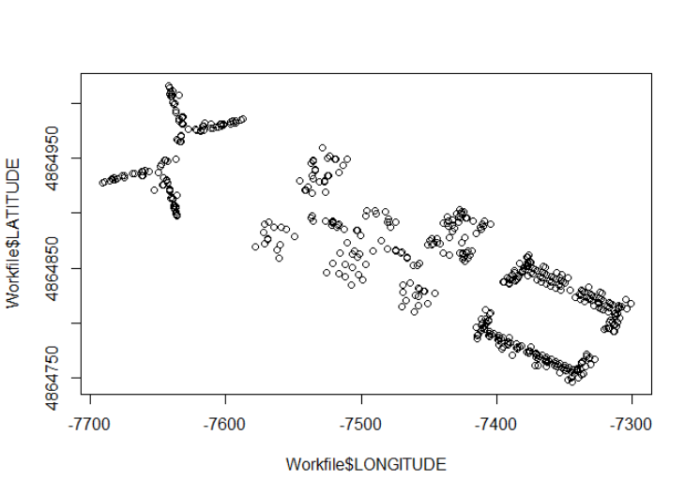
Plot longitude / latitude - Training

Slide 10
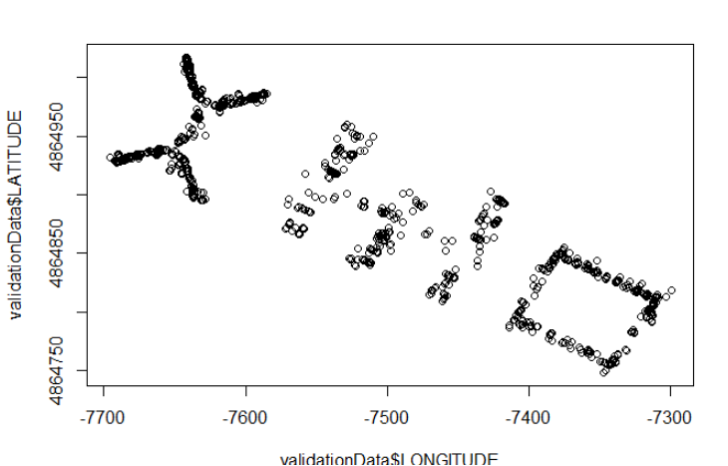
Plot long / lat – Training vs Validation

Slide 11
^{test} KNN in EDA fase
Fit_long
k-Nearest Neighbors
1502 samples
529 predictor
Pre-processing: median imputation (525), remove (122)
Resampling: Cross-Validated (10 fold, repeated 1 times)
Summary of sample sizes: 1352, 1353, 1352, 1351, 1351, 1352, ...
Resampling results across tuning parameters:
k RMSE Rsquared MAE
5 13.25943 0.9885509 7.446795
7 15.20129 0.9849412 8.750156
9 16.84683 0.9814590 9.967150
RMSE was used to select the optimal model using the smallest value.
The final value used for the model was k = 5.

Slide 12
1st KNN model on full data filtered per building sample size 7500 DataPartition 75%

Slide 13
1st KNN-model results for Lat/Long
Sample: 7500, DataPartition: .75
method = "kknn",
trControl=fitControl,
tuneLength = 5,
verboseIter = TRUE,
preProcess = c("zv", "medianImpute"))
Fit_lat_B0 <- train(LATITUDE ~.,
data = training_B0_lat,
method = "kknn",
trControl=fitControl,
tuneLength = 5,
verboseIter = TRUE,
preProcess = c("zv", "medianImpute"))
Fit_lat_B0
saveRDS(Fit_lat_B0, file = "KNN_Fit_lat_B0.rds")
#k RMSE Rsquared MAE
#5 6.460450 0.9588620 3.660657
#Fit_lat_B0 postresample----
postResample(pred = predict(object = Fit_lat_B0,
newdata = testing_B0_lat),
obs = testing_B0_lat$LATITUDE)
# RMSE Rsquared MAE
# 6.7003103 0.9609583 4.0250448
Fit_lat_B1 <- train(LATITUDE~.,
data = training_B1_lat,
method = "kknn",
trControl=fitControl,
tuneLength = 5,
verboseIter = TRUE,
preProcess = c("zv", "medianImpute"))
Fit_lat_B1
saveRDS(Fit_lat_B1, file = "KNN_Fit_lat_B1.rds")
#k RMSE Rsquared MAE
#5 8.241445 0.9482391 4.979434
#Fit_lat_B1 postresample----
postResample(pred = predict(object = Fit_lat_B1,
newdata = testing_B1_lat),
obs = testing_B1_lat$LATITUDE)
# RMSE Rsquared MAE
# 6.7663285 0.9645302 4.4480253
Fit_lat_B2 <- train(LATITUDE~.,
data = training_B2_lat,
method = "kknn",
trControl=fitControl,
tuneLength = 5,
verboseIter = TRUE,
preProcess = c("zv", "medianImpute"))
Fit_lat_B2
saveRDS(Fit_lat_B2, file = "KNN_Fit_lat_B2.rds")
#k RMSE Rsquared MAE
#5 7.088801 0.9365169 3.989857
#Fit_lat_B2 postresample----
postResample(pred = predict(object = Fit_lat_B2,
newdata = testing_B2_lat),
obs = testing_B2_lat$LATITUDE)
# RMSE Rsquared MAE
# 6.0978035 0.9547484 3.4121850
Fit_long_B0 <- train(LONGITUDE~.,
data = training_B0_long,
method = "kknn",
trControl=fitControl,
tuneLength = 5,
verboseIter = TRUE,
preProcess = c("zv", "medianImpute"))
Fit_long_B0
saveRDS(Fit_long_B0, file = "KNN_Fit_long_B0.rds")
#k RMSE Rsquared MAE
#5 7.311088 0.9158382 4.482322
#Fit_long_B0 postresample----
postResample(pred = predict(object = Fit_long_B0,
newdata = testing_B0_long),
obs = testing_B0_long$LONGITUDE)
# RMSE Rsquared MAE
# 6.5256682 0.9337054 4.1474910
Fit_long_B1 <- train(LONGITUDE~.,
data = training_B1_long,
method = "kknn",
trControl=fitControl,
tuneLength = 5,
verboseIter = TRUE,
preProcess = c("zv", "medianImpute"))
Fit_long_B1
saveRDS(Fit_long_B1, file = "KNN_Fit_long_B1.rds")
#k RMSE Rsquared MAE
#5 8.538631 0.9698672 5.201769
#Fit_long_B1 postresample----
postResample(pred = predict(object = Fit_long_B1,
newdata = testing_B1_long),
obs = testing_B1_long$LONGITUDE)
# RMSE Rsquared MAE
# 7.890551 0.974103 5.055423
Fit_long_B2 <- train(LONGITUDE~.,
data = training_B2_long,
method = "kknn",
trControl=fitControl,
tuneLength = 5,
verboseIter = TRUE,
preProcess = c("zv", "medianImpute"))
Fit_long_B2
saveRDS(Fit_long_B2, file = "KNN_Fit_long_B2.rds")
#k RMSE Rsquared MAE
#5 9.455415 0.8973102 5.114687
#Fit_long_B2 postresample----
postResample(pred = predict(object = Fit_long_B2,
newdata = testing_B2_long),
obs = testing_B2_long$LONGITUDE)
# RMSE Rsquared MAE
# 9.2788440 0.9006733 4.9395021

Slide 14
1st KNN-model Lat/Long summary
Combi_StatSum_Lat
# RMSE RSQ MAE
#B0 6.700310 96.02481 4.025045
#B1 6.700310 96.47526 4.448025
#B2 6.097803 95.41785 3.412185
Combi_StatSum_Long
# RMSE RSQ MAE
#B0 6.525668 93.29991 4.147491
#B1 7.890551 97.40207 5.055423
#B2 9.278844 90.12502 4.939502

Slide 15

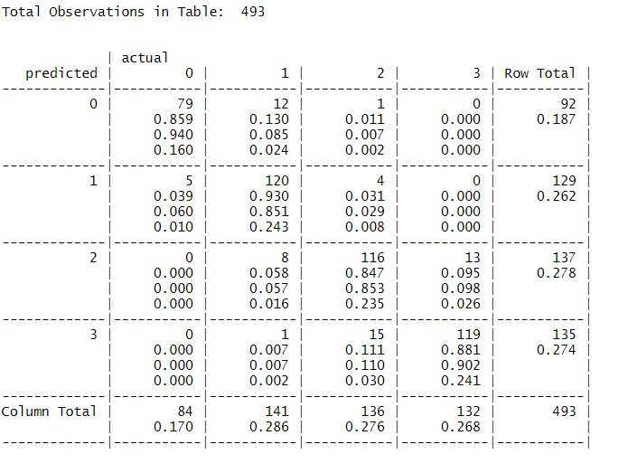
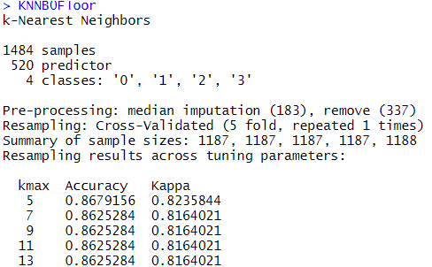
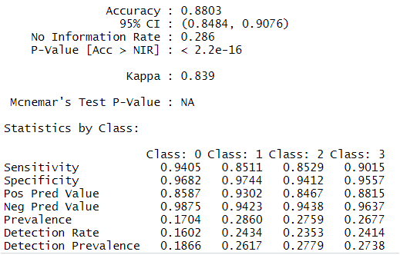
1st KNN Floor B0 CF
Kknn-5 can be optimized for floor Building 0 esp. floor 1, 2, 3
FLOOR
In Building 0
79 predictions for floor 0 were True Positives
120 predictions for floor 1 were True Positives
116 predictions for floor 2 were True Positives
119 predictions for floor 3 were True Positives
In 12 cases floor 1 was misidentified as 0 & 1 times floor 2 was misidentified as 0
In 5 cases floor 0 was misidentified as being floor 1 & in 4 cases floor 2 was misidentified as 1
In 8 cases floor 1 was misidentified as being floor 2 & in 13 cases floor 3 was misidentified as 2
In 1 case floor 1 was misidentified as being floor 3 & in 15 cases floor 2 was misidentified as 3

Slide 16
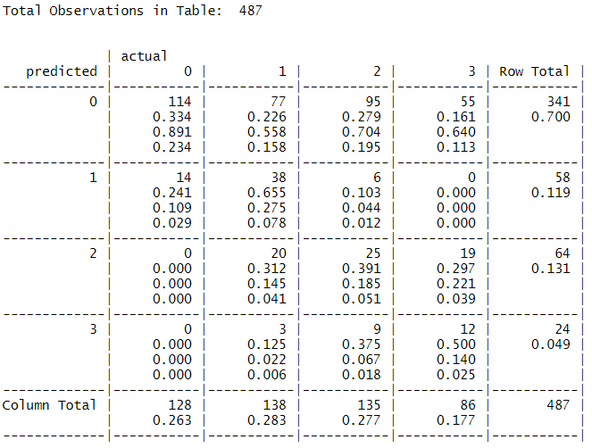
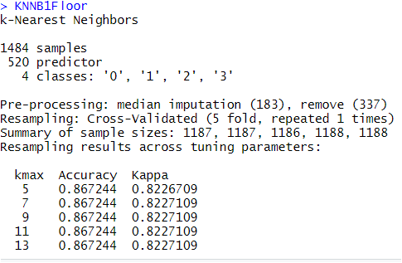
1st KNN Floor B1 CF
B1 predictions for floor has an accuracy of 38.8% & esp. floor 1,2,3 is not predicted well
FLOOR
In Building 1
114 predictions for floor 0 were True Positives
38 predictions for floor 1 were True Positives
25 predictions for floor 2 were True Positives
12 predictions for floor 3 were True Positives
In 77 cases floor 1 was misidentified as 0, 95 were identied as floor 2 and 55 as floor 3 instead of 0
In 14 cases floor 0 was misidentified as being floor 1 & in 6 cases floor 2 was misidentified as 1
In 20 cases floor 1 was misidentified as being floor 2 & in 19 cases floor 3 was misidentified as 2
In 3 case floor 1 was misidentified as being floor 3 & in 9 cases floor 2 was misidentified as floor 3
Overall Statistics
#Accuracy : 0.3881
#95% CI : (0.3446, 0.433)
#Kappa : 0.1698

Slide 17
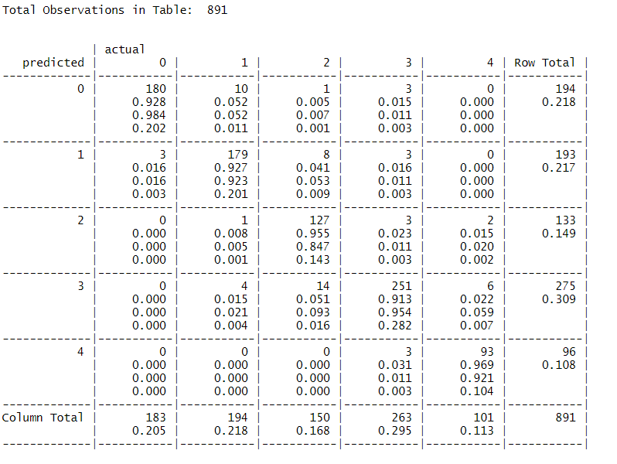
1st KNN Floor B2 Confusion Matrix
FLOOR
Kknn-5 was working fine for predictions in Building 2
In Building 2
180 predictions for floor 0 were True Positives
179 predictions for floor 1 were True Positives
127 predictions for floor 2 were True Positives
251 predictions for floor 3 were True Positives
93 predictions for floor 4 were True Positives
In 10 cases floor 1 was misidentified as 0, 1 was identified as floor 2 and 3 as floor 3 instead of 0
In 3 cases floor 0 was misidentified as being floor 1 & in 8 cases floor 2 was misidentified as 1
In 1 case floor 1 was misidentified as being floor 2 & in 3 cases floor 3 as 2 & 2 cases floor 4 as 2
In 4 cases floor 1 was misidentified as being floor 3 & in 6 cases floor 4 was misidentified as floor 3
In 3 cases floor 3 was misidentified as being floor 4 .

Slide 18
Training KPI’s 2nd KNN model on full data filtered per building

Slide 19
^{2nd} KNN B0
Training KPI’s
FLOOR
LATITUDE
#k Accuracy Kappa
#13 0.9223176 0.8961545
Fit_lat_B0 k-Nearest Neighbors 3939 samples 520 predictor Pre-processing: median imputation (197), remove (323) Resampling: Cross-Validated (5 fold, repeated 1 times) Summary of sample sizes: 3152, 3150, 3150, 3153, 3151 Resampling results across tuning parameters:
kmax RMSE Rsquared MAE 5
5.840343 0.9680237 2.806226
postResample(pred = predict(object = Fit_lat_B0,
+ newdata = testing_B0_lat),
+ obs = testing_B0_lat$LATITUDE)
RMSE Rsquared MAE
5.982871 0.967413 3.168045
Training KPI’s
Fit_floor_B0 k-Nearest Neighbors
3939 samples 520 predictor 4 classes: '0', '1', '2', '3'
Pre-processing: median imputation (196), remove (324)
Resampling: Cross-Validated (5 fold, repeated 1 times)
Summary of sample sizes: 3151, 3151, 3151, 3152, 3151
Resampling results across tuning parameters:
kmax Accuracy Kappa
13 0.9223176 0.8961545
LONGITUDE
Fit_lONG_B0 k-Nearest Neighbors 3939 samples 520 predictor
Pre-processing: median imputation (198), remove (322)
Resampling: Cross-Validated (5 fold, repeated 1 times)
Summary of sample sizes: 3152, 3151, 3151, 3151, 3151
Resampling results across tuning parameters:
kmax RMSE Rsquared MAE
5 5.962481 0.9436714 3.075533
postResample(pred = predict(object = Fit_long_B0,
+ newdata = testing_B0_long),
+ obs = testing_B0_long$LONGITUDE)
RMSE Rsquared MAE
5.6387300 0.9480333 3.0377195

Slide 20
^{2nd} KNN B1
FLOOR
Training KPI’s
#k Accuracy Kappa
#7 0.9157089 0.8873319
Training KPI’s
Fit_floor_B1 k-Nearest Neighbors
3939 samples
520 predictor
4 classes: '0', '1', '2', '3'
Pre-processing: median imputation (196), remove (324)
Resampling: Cross-Validated (5 fold, repeated 1 times)
Summary of sample sizes: 3150, 3151, 3152, 3151, 3152
Resampling results across tuning parameters:
kmax Accuracy Kappa
7 0.9157089 0.8873319
LATITUDE
> postResample(pred = predict(object = Fit_lat_B1,
+ newdata = testing_B1_lat),
+ obs = testing_B1_lat$LATITUDE)
RMSE Rsquared MAE
5.8600480 0.9735459 2.9833834
> Fit_lat_B1
k-Nearest Neighbors
3898 samples
520 predictor
Pre-processing: median imputation (207), remove (313)
Resampling: Cross-Validated (5 fold, repeated 1 times)
Summary of sample sizes: 3118, 3119, 3118, 3119, 3118
Resampling results across tuning parameters:
kmax RMSE Rsquared MAE
5 6.506556 0.9679517 3.369182
LONGITUDE
postResample(pred = predict(object = Fit_long_B1,
+ newdata = testing_B1_long),
+ obs = testing_B1_long$LONGITUDE)
RMSE Rsquared MAE
6.6183878 0.9819367 3.3280642
Fit_long_B1 k-Nearest Neighbors
3898 samples
520 predictor
Pre-processing: median imputation (204), remove (316)
Resampling: Cross-Validated (5 fold, repeated 1 times)
Summary of sample sizes: 3119, 3119, 3116, 3119, 3119
Resampling results across tuning parameters:
kmax RMSE Rsquared MAE
5 7.441228 0.9775019 3.678046

Slide 21
^{2nd} KNN B2
FLOOR
Training KPI’s
#k Accuracy Kappa
#7 0.9603923 0.9494419
Training KPI’s
LATITUDE
postResample(pred = predict(object = Fit_lat_B2,
newdata = testing_B2_lat),
obs = testing_B2_lat$LATITUDE)
# RMSE Rsquared MAE
# 4.9402155 0.9682882 2.5529108 0
Fit_floor_B2 k-Nearest Neighbors
7120 samples 520 predictor
5 classes: '0', '1', '2', '3', '4'
Pre-processing: median imputation (201), remove (319)
Resampling: Cross-Validated (5 fold, repeated 1 times)
Summary of sample sizes: 5695, 5697, 5697, 5696, 5695
Resampling results across tuning parameters:
kmax Accuracy Kappa
7 0.9603923 0.9494419
Fit_lat_B2
k-Nearest Neighbors
7121 samples
520 predictor
Pre-processing: median imputation (201), remove (319)
Resampling: Cross-Validated (5 fold, repeated 1 times)
Summary of sample sizes: 5697, 5697, 5696, 5697, 5697
Resampling results across tuning parameters:
kmax RMSE Rsquared MAE
5 5.645028 0.9601617 2.843604
LONGITUDE
postResample(pred = predict(object = Fit_long_B2,
+ newdata = testing_B2_long),
+ obs = testing_B2_long$LONGITUDE)
RMSE Rsquared MAE
7.3556032 0.9404916 3.3675497
Fit_long_B2 k-Nearest Neighbors
7120 samples
520 predictor
Pre-processing: median imputation (202), remove (318)
Resampling: Cross-Validated (5 fold, repeated 1 times)
Summary of sample sizes: 5695, 5697, 5696, 5697, 5695
Resampling results across tuning parameters:
kmax RMSE Rsquared MAE
5 7.577559 0.9354733 3.559215
Fit_long_B2 Fit_long_B2
k-Nearest Neighbors 7120 samples
520 predictor
Pre-processing: median imputation (202), remove (318)
Resampling: Cross-Validated (5 fold, repeated 1 times)
Summary of sample sizes: 5695, 5697, 5696, 5697, 5695
Resampling results across tuning parameters:
kmax RMSE Rsquared MAE
5 7.577559 0.9354733 3.559215

Slide 22
2nd KNN-model summary training KPI’s
All obs per building, DataPartition: .75
method = "kknn",
trControl=fitControl,
tuneLength = 5,
verboseIter = TRUE,
preProcess = c("zv", "medianImpute"))
Fit_lat_B0
k-Nearest Neighbors
3939 samples
520 predictor
Pre-processing: median imputation (197), remove (323) Resampling: Cross-Validated (5 fold, repeated 1 times)
Summary of sample sizes: 3152, 3150, 3150, 3153, 3151
Resampling results across tuning parameters:
kmax RMSE Rsquared MAE 5
5.840343 0.9680237 2.806226
> Fit_lat_B1
k-Nearest Neighbors
3898 samples
520 predictor
Pre-processing: median imputation (207), remove (313)
Resampling: Cross-Validated (5 fold, repeated 1 times)
Summary of sample sizes: 3118, 3119, 3118, 3119, 3118
Resampling results across tuning parameters:
kmax RMSE Rsquared MAE
5 6.506556 0.9679517 3.369182
Fit_lat_B2
k-Nearest Neighbors
7121 samples
520 predictor
Pre-processing: median imputation (201), remove (319)
Resampling: Cross-Validated (5 fold, repeated 1 times)
Summary of sample sizes: 5697, 5697, 5696, 5697, 5697
Resampling results across tuning parameters:
kmax RMSE Rsquared MAE
5 5.645028 0.9601617 2.843604
postResample(pred = predict(object = Fit_lat_B0,
+ newdata = testing_B0_lat),
+ obs = testing_B0_lat$LATITUDE)
RMSE Rsquared MAE
5.982871 0.967413 3.168045
> postResample(pred = predict(object = Fit_lat_B1,
+ newdata = testing_B1_lat),
+ obs = testing_B1_lat$LATITUDE)
RMSE Rsquared MAE
5.8600480 0.9735459 2.9833834
postResample(pred = predict(object = Fit_lat_B2,
newdata = testing_B2_lat),
obs = testing_B2_lat$LATITUDE)
# RMSE Rsquared MAE
# 4.9402155 0.9682882 2.5529108 0
Fit_lONG_B0 k-Nearest Neighbors 3939 samples
520 predictor
Pre-processing: median imputation (198), remove (322)
Resampling: Cross-Validated (5 fold, repeated 1 times)
Summary of sample sizes: 3152, 3151, 3151, 3151, 3151
Resampling results across tuning parameters:
kmax RMSE Rsquared MAE
5 5.962481 0.9436714 3.075533
Fit_long_B1 k-Nearest Neighbors
3898 samples
520 predictor
Pre-processing: median imputation (204), remove (316)
Resampling: Cross-Validated (5 fold, repeated 1 times)
Summary of sample sizes: 3119, 3119, 3116, 3119, 3119
Resampling results across tuning parameters:
kmax RMSE Rsquared MAE
5 7.441228 0.9775019 3.678046
Fit_long_B2 k-Nearest Neighbors
7120 samples
520 predictor
Pre-processing: median imputation (202), remove (318)
Resampling: Cross-Validated (5 fold, repeated 1 times)
Summary of sample sizes: 5695, 5697, 5696, 5697, 5695
Resampling results across tuning parameters:
kmax RMSE Rsquared MAE
5 7.577559 0.9354733 3.559215
postResample(pred = predict(object = Fit_long_B0,
+ newdata = testing_B0_long),
+ obs = testing_B0_long$LONGITUDE)
RMSE Rsquared MAE
5.6387300 0.9480333 3.0377195
postResample(pred = predict(object = Fit_long_B1,
+ newdata = testing_B1_long),
+ obs = testing_B1_long$LONGITUDE)
RMSE Rsquared MAE
6.6183878 0.9819367 3.3280642
postResample(pred = predict(object = Fit_long_B2,
+ newdata = testing_B2_long),
+ obs = testing_B2_long$LONGITUDE)
RMSE Rsquared MAE
7.3556032 0.9404916 3.3675497

Slide 23
Prediction KPI’s KNN-5 all obs per building for lat/long/floor

Slide 24
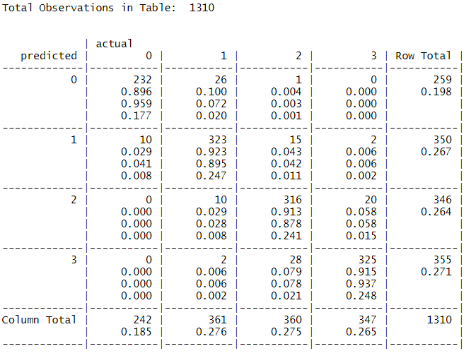
^{2nd} KNN B0
kappa_KNNB0Floor Confusion Matrix
value ASE z Pr(>|z|)
Unweighted 0.8833 0.010453 84.5 0
Weighted 0.9242 0.007019 131.7 0
Accuracy 32.25558
In Building 0
232 predictions for floor 0 were True Positives
323predictions for floor 1 were True Positives
316 predictions for floor 2 were True Positives
325 predictions for floor 3 were True Positives
In 26 cases floor 1 was misidentified as 0 & 1 times floor 2 was misidentified as 0
In 10 cases floor 0 was misidentified as being floor 1 & in 15 cases floor 2 was misidentified as 1
In 10 cases floor 1 was misidentified as being floor 2 & in 20 cases floor 3 was misidentified as 2
In 2 case floor 1 was misidentified as being floor 3 & in 28 cases floor 2 was misidentified as 3
FLOOR
KNNB0Floor Model
k-Nearest Neighbors
3939 samples
520 predictor
4 classes: '0', '1', '2', '3'
Pre-processing: median imputation (196), remove (324)
Resampling: Cross-Validated (5 fold, repeated 1 times)
Summary of sample sizes: 3151, 3151, 3151, 3152, 3151
Resampling results across tuning parameters:
kmax Accuracy Kappa
5 0.9185105 0.8910259
7 0.9207948 0.8941163
9 0.9218100 0.8954735
11 0.9223176 0.8961545
13 0.9223176 0.8961545

Slide 25
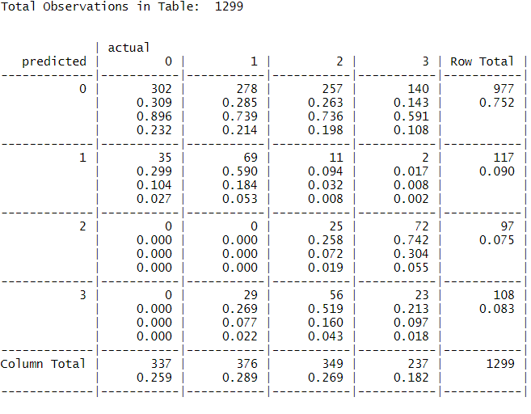
^{2nd} KNN B1
Often floors are identified as 0, while being 1, 2 or 3
kappa_KNNB1Floor Confusion Matrix
value ASE z Pr(>|z|)
Unweighted 0.08894 0.01225 7.258 3.915e-13
Weighted 0.15751 0.01364 11.548 7.518e-31
Accuracy
In Building 1
302 predictions for floor 0 were True Positives
69 predictions for floor 1 were True Positives
25 predictions for floor 2 were True Positives
23 predictions for floor 3 were True Positives
In 278 cases floor 1 was misidentified as 0 & 257 times floor 2 + 140 times floor 3 was misidentified as 0
In 35 cases floor 0 was misidentified as being floor 1 & in 11 cases floor 2 was misidentified as 1
In 72 cases floor 3 was misidentified as floor 2 while being 3
In 29 cases floor 1 was misidentified as being floor 3 & in 23 cases floor 2 was misidentified as 3
FLOOR
KNNB1Floor Model
k-Nearest Neighbors
3939 samples
520 predictor
4 classes: '0', '1', '2', '3'
Pre-processing: median imputation (196), remove (324)
Resampling: Cross-Validated (5 fold, repeated 1 times)
Summary of sample sizes: 3150, 3151, 3152, 3151, 3152
Resampling results across tuning parameters:
kmax Accuracy Kappa
5 0.9111391 0.8811726
7 0.9157089 0.8873319
9 0.9154551 0.8869937
11 0.9154551 0.8869956
13 0.9154551 0.8869956

Slide 26
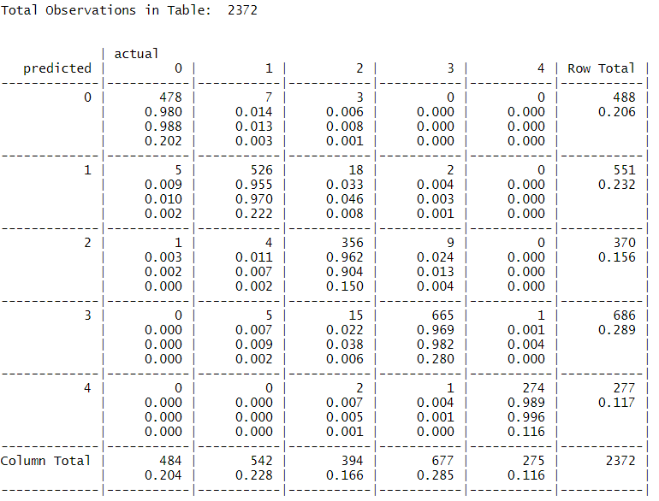
^{2nd} KNN B2
kappa_KNNB2Floor Confusion Matrix
value ASE z Pr(>|z|)
Unweighted 0.9607 0.004529 212.1 0
Weighted 0.9759 0.002948 331.0 0
Accuracy 96.92243
In Building 2
478 predictions for floor 0 were True Positives
526 predictions for floor 1 were True Positives
356 predictions for floor 2 were True Positives
665 predictions for floor 3 were True Positives
274 predictions for floor 4 were True Positives
In 17 cases floor 1 was misidentified as 0 & 3 times floor 2 was misidentified as 0
In 5 cases floor 0 was misidentified as being floor 1 & in 18 cases floor 2 was misidentified as 1
In 4 cases floor 1 was misidentified as being floor 2 & in 9 cases floor 3 was misidentified as 2
In 5 case floor 1 was misidentified as being floor 3 & in 15 cases floor 2 was misidentified as 3
In 2 case floor 2 was misidentified as being floor 4 & in 1 case floor 3 was misidentified as 4
FLOOR
KNNB2Floor Model
k-Nearest Neighbors
7120 samples
520 predictor
5 classes: '0', '1', '2', '3', '4'
Pre-processing: median imputation (201), remove (319)
Resampling: Cross-Validated (5 fold, repeated 1 times)
Summary of sample sizes: 5695, 5697, 5697, 5696, 5695
Resampling results across tuning parameters:
kmax Accuracy Kappa
5 0.9588484 0.9474698
7 0.9603923 0.9494419
9 0.9601116 0.9490859
11 0.9601116 0.9490859
13 0.9601116 0.9490859

Slide 27
2nd KNN-model Lat/Long/Floor KPI summary
Combi_StatSum_Lat
# RMSE RSQ MAE
B0 5.982871 96.71153 3.168045
B1 5.982871 97.21531 2.983383
B2 4.940216 96.81935 2.552911
Combi_StatSum_Long
# RMSE RSQ MAE
B0 5.638730 94.79819 3.037719
B1 6.618388 98.19182 3.328064
B2 7.355603 94.04222 3.367550
FLOOR
Acc
B0 91.29771
B1 32.25558
B2 96.92243
#kappa
#B0 Weighted 0.883266749
#B0 ASE 0.010453337
#B1 Weighted 0.088937612
#B1 ASE 0.012252931
#B2 Weighted 0.960692577
#B2 ASE 0.004528678

Slide 28
Conclusions of 2nd KNN predictions
First focus is to improve the predictions for Building 1 and have a higher accuracy without downsizing the KPI’s for other Buildings.
Data represents data for Building 0, 1 & 2. Building 1 is therefore in the middle and between 0 & 2
In building 1 its difficult to predict the correct floor and its often therefore predicted as a lower floor.
Therefore:
Check distribution of signals
Check signals per user for the building
Check signal per phone for the buildings
Plot signals for the buildings to see coverage and if taken in or outside the room
3d plot signals per floor in the building
Plot signal strength for good, medium and bad for the buildings

Slide 29
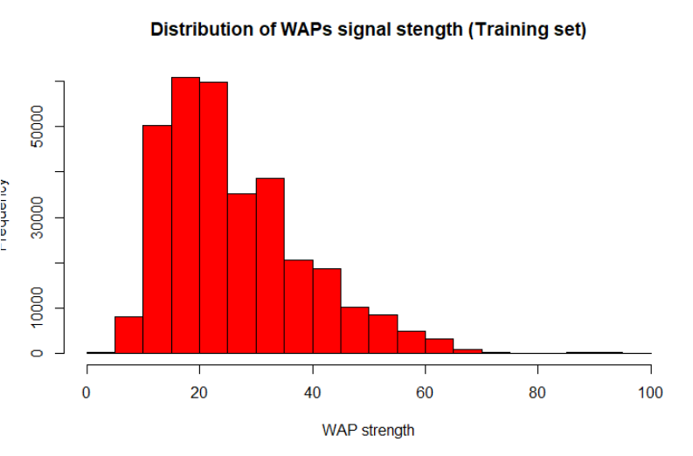
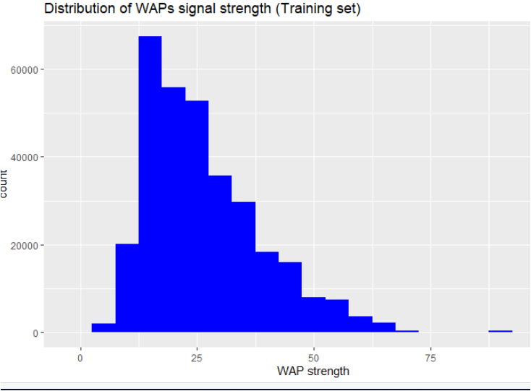
3rd Preprocess data and clean from 100
Detected columns with only 100 values and removed them (using function x, select = unique length)
Detected rows with 100 values and removed them (none)
Set Floor, building ID, Relative position, user id & phone id to factor. Left Timestamp as is (before converted)
Changed WAP signals to positives by adding 105 and after converting 100 to -105 and so that no signal is 0 and the highest is 104
Checked the distribution of WAP signals after this and plotted this (see below)

Slide 30
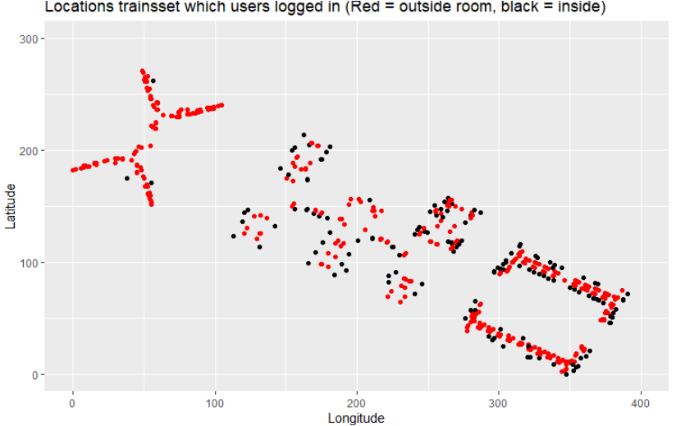
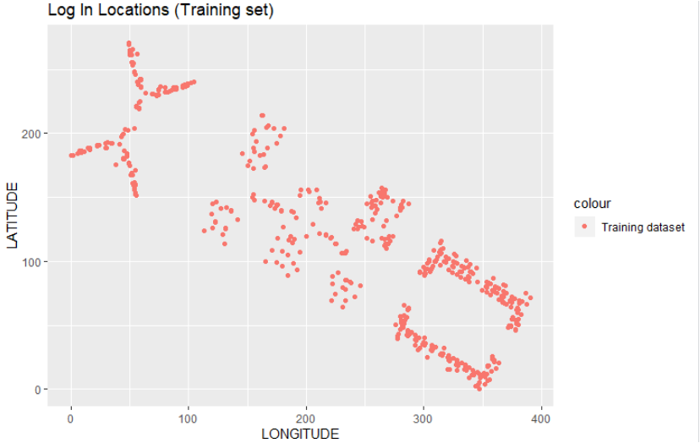
3rd Check longitude / latitude
Converted long/lat to absolute values
And check the coverage of locations where users logged in

Slide 31
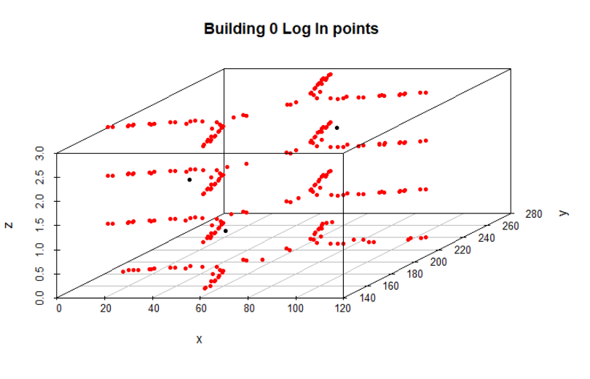
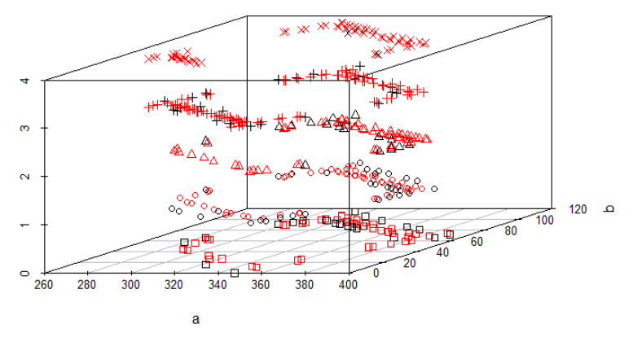
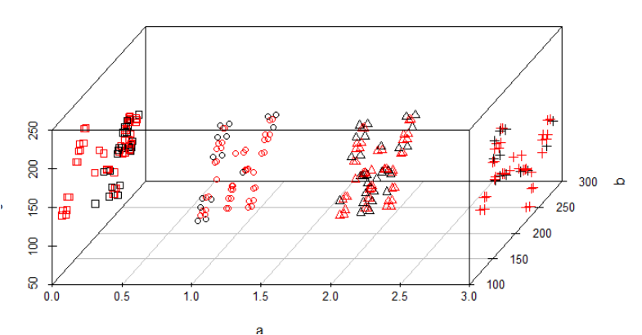
3rd Check coverage per building per floor
Converted long/lat to absolute values
And check the coverage of locations where users logged in per building per floor
Building 2 Log in Points
Building 1 Log in Points

Slide 32
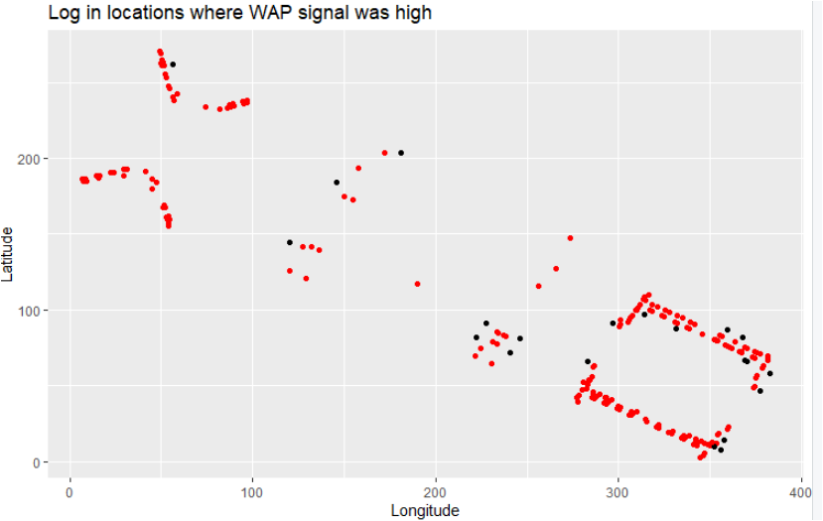
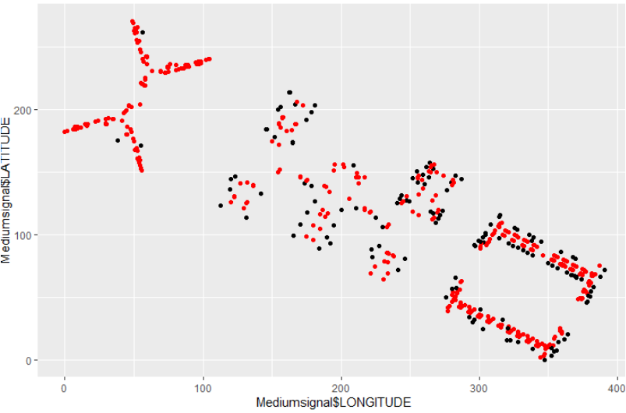
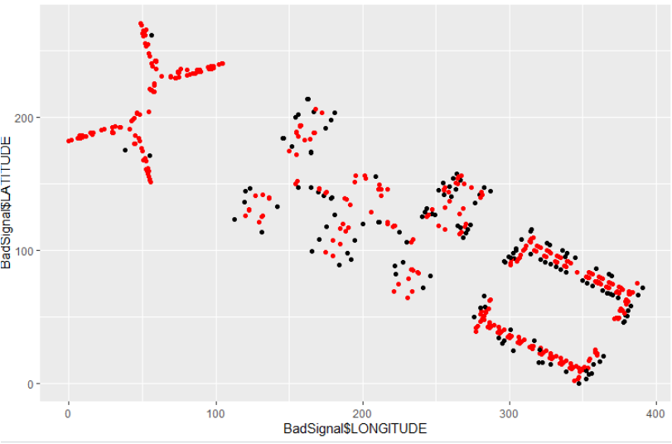
3rd Signal check per building
Good Signal
Medium Signal
Bad Signal

Slide 33
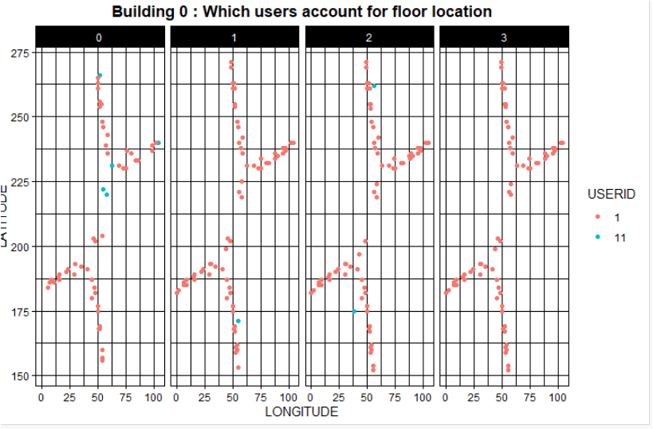
Users linked to Building 0

Slide 34
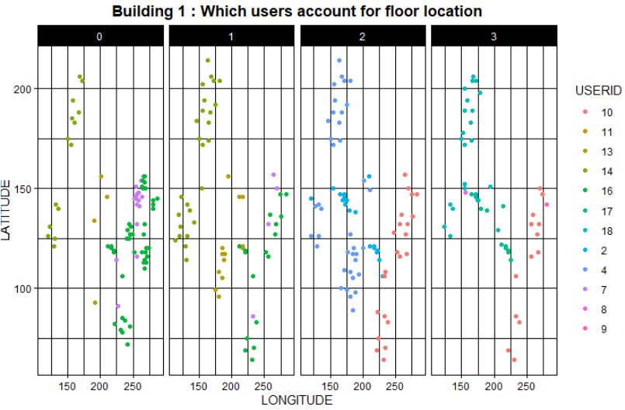
Users linked to Building 1

Slide 35
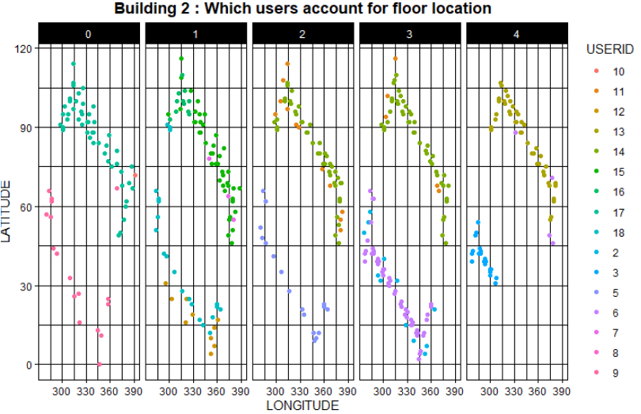
Users linked to Building 2

Slide 36
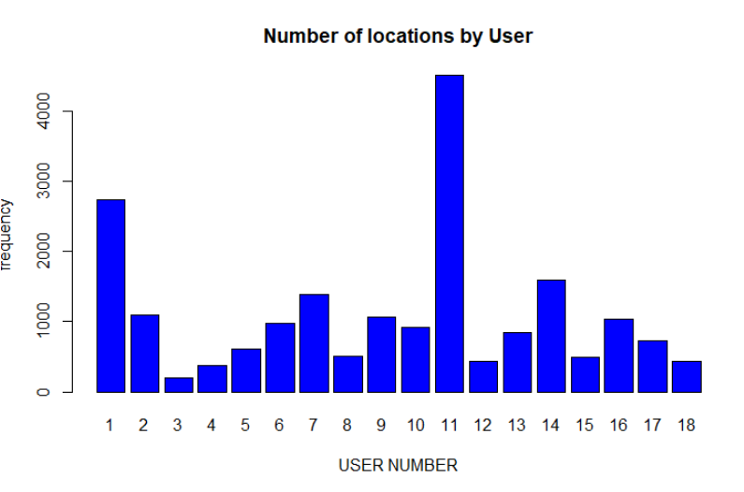
How many locations have a user registered

Slide 37
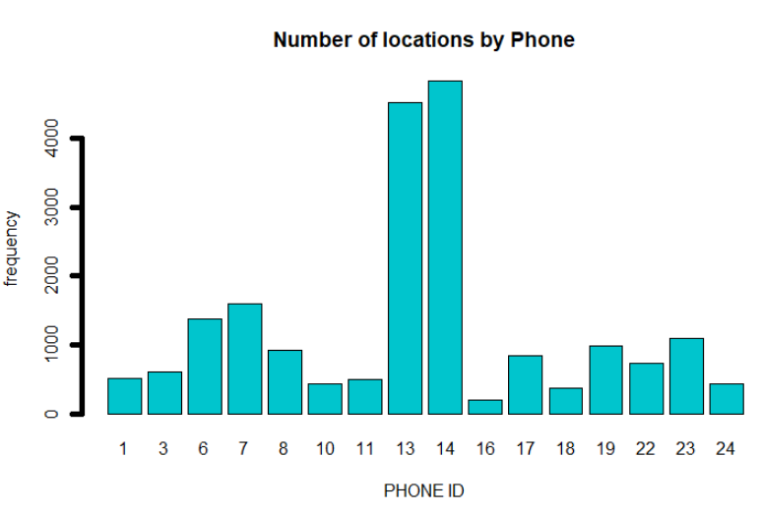
Number of locations registered by Phone id

Slide 38
3rd Prediction KPI’s KNN-5 all obs per building for lat/long/floor + Random Forest

Slide 39
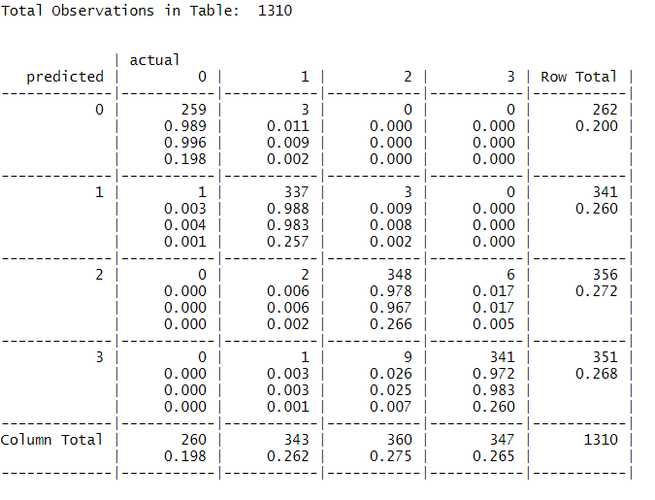
^{3rd} KNN B0
kappa_KNNB0Floor Confusion Matrix
value ASE z Pr(>|z|)
Unweighted 0.8833 0.010453 84.5 0
Weighted 0.9242 0.007019 131.7 0
Accuracy 32.25558
In Building 0
259 predictions for floor 0 were True Positives
337 predictions for floor 1 were True Positives
348 predictions for floor 2 were True Positives
325 predictions for floor 3 were True Positives
In 9 cases floor 2 was misidentified as 3
FLOOR
KNNB0Floor Model
k-Nearest Neighbors
3939 samples
520 predictor
4 classes: '0', '1', '2', '3'
Pre-processing: median imputation (196), remove (324)
Resampling: Cross-Validated (5 fold, repeated 1 times)
Summary of sample sizes: 3151, 3151, 3151, 3152, 3151
Resampling results across tuning parameters:
kmax Accuracy Kappa
5 0.9185105 0.8910259
7 0.9207948 0.8941163
9 0.9218100 0.8954735
11 0.9223176 0.8961545
13 0.9223176 0.8961545

Slide 40
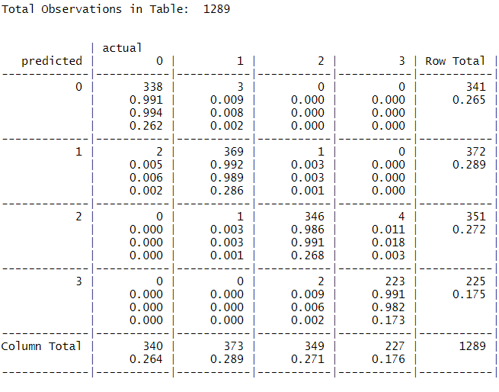
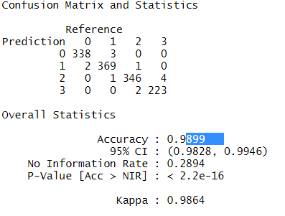
^{3rd} KNN B1
kappa_KNNB1Floor Confusion Matrix
value ASE z Pr(>|z|)
Unweighted 0.08894 0.01225 7.258 3.915e-13
Weighted 0.15751 0.01364 11.548 7.518e-31
Accuracy
In Building 1
338 predictions for floor 0 were True Positives
369predictions for floor 1 were True Positives
346 predictions for floor 2 were True Positives
223 predictions for floor 3 were True Positives
FLOOR

Slide 41
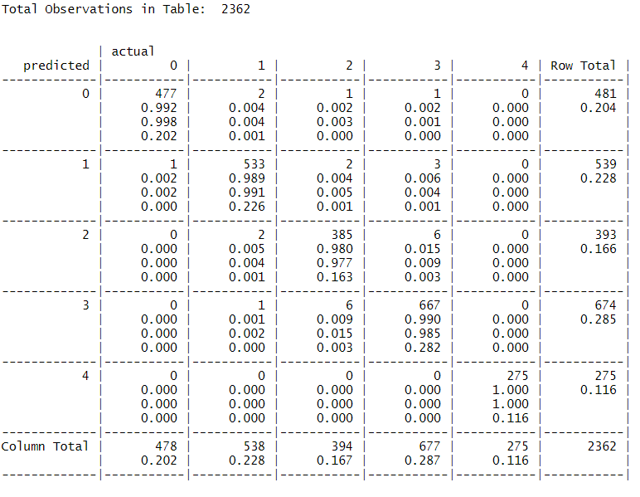
^{3rd} KNN B2
kappa_KNNB2Floor Confusion Matrix
value ASE z Pr(>|z|)
Unweighted 0.9607 0.004529 212.1 0
Weighted 0.9759 0.002948 331.0 0
Accuracy 96.92243
In Building 2
477predictions for floor 0 were True Positives
533 predictions for floor 1 were True Positives
385predictions for floor 2 were True Positives
667 predictions for floor 3 were True Positives
275 predictions for floor 4 were True Positives
In 17 cases floor 1 was misidentified as 0 & 3 times floor 2 was misidentified as 0
In 5 cases floor 0 was misidentified as being floor 1 & in 18 cases floor 2 was misidentified as 1
In 4 cases floor 1 was misidentified as being floor 2 & in 9 cases floor 3 was misidentified as 2
In 5 case floor 1 was misidentified as being floor 3 & in 15 cases floor 2 was misidentified as 3
In 2 case floor 2 was misidentified as being floor 4 & in 1 case floor 3 was misidentified as 4
FLOOR
KNNB2Floor Model
k-Nearest Neighbors
7120 samples
520 predictor
5 classes: '0', '1', '2', '3', '4'
Pre-processing: median imputation (201), remove (319)
Resampling: Cross-Validated (5 fold, repeated 1 times)
Summary of sample sizes: 5695, 5697, 5697, 5696, 5695
Resampling results across tuning parameters:
kmax Accuracy Kappa
5 0.9588484 0.9474698
7 0.9603923 0.9494419
9 0.9601116 0.9490859
11 0.9601116 0.9490859
13 0.9601116 0.9490859

Slide 42



3rd KNN-model Lat/Long/Floor KPI summary
Combi_StatSum_Lat
# RMSE RSQ MAE
B0 4.200349 98.38193 2.067570
B1 4.200349 98.62613 1.977748
B2 3.650701 98.32693 1.846340
Combi_StatSum_Long
# RMSE RSQ MAE
B0 3.245267 98.27749 1.613786
B1 3.746984 99.42940 1.248799
B2 4.269281 97.96087 1.841995
#kappa B0
FLOOR
Kappa
kappa
1 0.9969313489
2 0.0017695433
3 -0.0029030734
4 0.0016738360
5 0.9994596997
6 0.0005401941
FLOOR
Acc
B0 98.09160
B1 36.22964
B2 98.94157
#kappa B1
#kappa B2

Slide 43
Conclusions of 3rd KNN predictions
- fffg

Slide 44
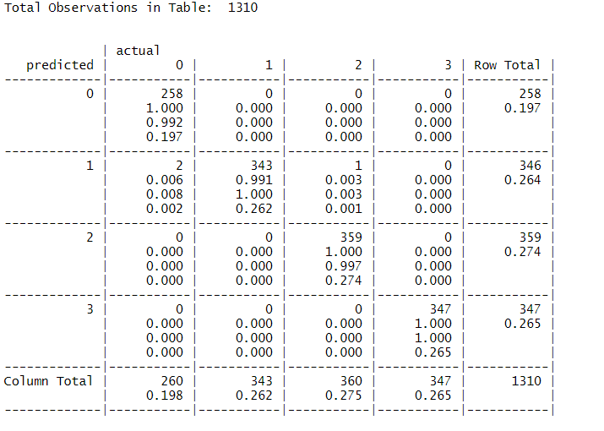
^{1st} RF B0
kappa_RFB0Floor Confusion Matrix
value ASE z Pr(>|z|)
Unweighted 0.9969 0.001770 563.4 0
Weighted 0.9981 0.001098 909.4 0
In Building 0
258 predictions for floor 0 were True Positives
343predictions for floor 1 were True Positives
359 predictions for floor 2 were True Positives
347 predictions for floor 3 were True Positives
In 26 cases floor 1 was misidentified as 0 & 1 times floor 2 was misidentified as 0
In 2 cases floor 0 was misidentified as being floor 1 & in 1 case floor 2 was misidentified as 1
FLOOR
RFB0Floor Model
Confusion Matrix and Statistics
predictions_RFB0Floor 0 1 2 3
0 258 0 0 0
1 2 343 1 0
2 0 0 359 0
3 0 0 0 347
Overall Statistics
Accuracy : 0.9977
95% CI : (0.9933, 0.9995)
No Information Rate : 0.2748
P-Value [Acc > NIR] : < 2.2e-16
Kappa : 0.9969

Slide 45
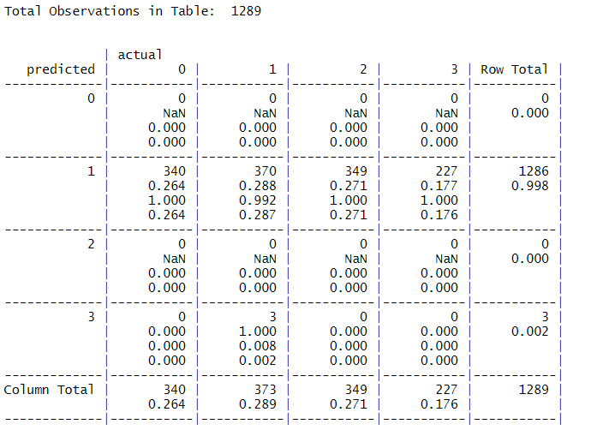
^{1st} RFB1
kappa_RFNB1Floor Confusion Matrix
value ASE z Pr(>|z|)
Unweighted -0.002903 0.001674 -1.734 0.08285
Weighted -0.003264 0.001880 -1.736 0.0825031
Often floors are identified as 0, while being 1, 2 or 3
In Building 1
0 predictions for floor 0 were True Positives
370 predictions for floor 1 were True Positives
0 predictions for floor 2 were True Positives
0 predictions for floor 3 were True Positives
In 340 cases floor 1 was misidentified as 0 & 349 times floor 2 + 227 times floor 3 was misidentified as 0
Other floors could hardly be predicted
FLOOR
KNNB1Floor Model
Confusion Matrix and Statistics
predictions_RFB1Floor 0 1 2 3
0 0 0 0 0
1 340 370 349 227
2 0 0 0 0
3 0 3 0 0
Overall Statistics
Accuracy : 0.287
95% CI : (0.2625, 0.3126)
No Information Rate : 0.2894
P-Value [Acc > NIR] : 0.5835
Kappa : -0.0029

Slide 46
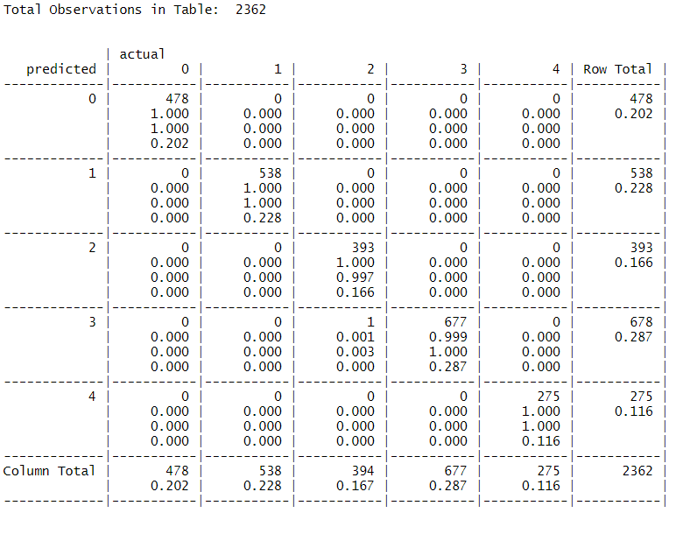
^{1st} RF B2
In Building 2
478 predictions for floor 0 were True Positives
538 predictions for floor 1 were True Positives
393 predictions for floor 2 were True Positives
677 predictions for floor 3 were True Positives
275 predictions for floor 4 were True Positives
kappa_RFB2Floor Confusion Matrix
value ASE z Pr(>|z|)
Unweighted 0.9995 ` 0.0005402 1850 0
Weighted 0.9997 0.0002822 3542 0
FLOOR
RFB2Floor Model
Confusion Matrix and Statistics
predictions_RFB2Floor 0 1 2 3 4
0 478 0 0 0 0
1 0 538 0 0 0
2 0 0 393 0 0
3 0 0 1 677 0
4 0 0 0 0 275
Overall Statistics
Accuracy : 0.9996
95% CI : (0.9976, 1)
No Information Rate : 0.2866
P-Value [Acc > NIR] : < 2.2e-16
Kappa : 0.9995

Slide 47
1st RF-model Lat/Long/Floor KPI summary
Combi_StatSum_Lat
# RMSE RSQ MAE
B0 4.200349 98.38193 2.067570
B1 4.200349 98.62613 1.977748
B2 3.650701 98.32693 1.846340
Combi_StatSum_Long
# RMSE RSQ MAE
B0 3.245267 98.82977 1.739514
B1 4.346220 99.23230 2.420201
B2 4.437505 97.79701 2.424726
#kappa
#B0 value ASE
Unweighted 0.9969 0.001770 563.4
Weighted 0.9981 0.001098 909.4
#B1
Unweighted -0.002903 0.001674
Weighted -0.003264 0.001880
#B2
Unweighted 0.9995 0.0005402
Weighted 0.9997 0.0002822
FLOOR
Acc
B0 99.77099
B1 28.70442
B2 9894.15749
FLOOR
Kappa
1 0.9969313489
2 0.0017695433
3 -0.0029030734
4 0.0016738360
5 0.9994596997
6 0.0005401941

Slide 48
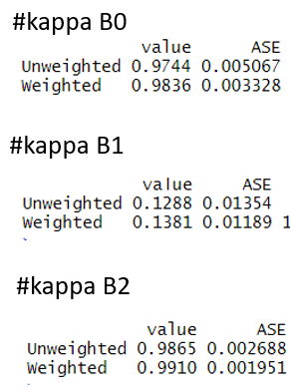
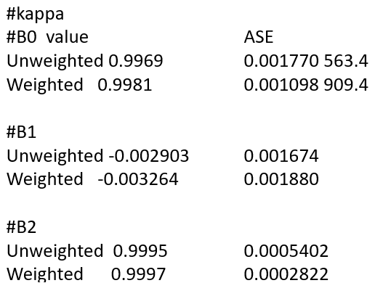
3rd KNN model compared to RF 1st model
Latitude / longitude KPI’s KNN
Combi_StatSum_Lat
# RMSE RSQ MAE
B0 4.200349 98.38193 2.067570
B1 4.200349 98.62613 1.977748
B2 3.650701 98.32693 1.846340
Combi_StatSum_Long
# RMSE RSQ MAE
B0 3.245267 98.27749 1.613786
B1 3.746984 99.42940 1.248799
B2 4.269281 97.96087 1.841995
Latitude / longitude KPI’s Random Forest
Combi_StatSum_Lat
# RMSE RSQ MAE
B0 2.277268 99.52439 1.314716
B1 2.277268 99.59617 2.151043
B2 3.325760 98.61151 1.990321
Combi_StatSum_Long
# RMSE RSQ MAE
B0 3.245267 98.82977 1.739514
B1 4.346220 99.23230 2.420201
B2 4.437505 97.79701 2.424726
FLOOR KNN
Acc
B0 98.09160
B1 36.22964
B2 98.94157
FLOOR RF
Acc
B0 99.77099
B1 28.70442
B2 9894.15749

Slide 49

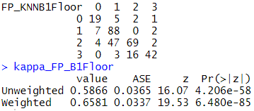
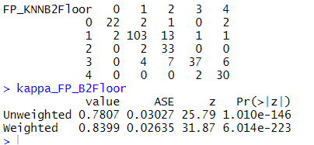
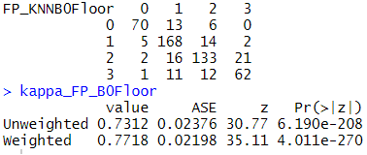
KPI’s 1st prediction based on KNN model

Slide 50



CF for Floor 1st pred_KNN model
B2
B0
B1

Slide 51



1st Pred Check long/lat

Slide 52

1st Pred check coverage per floor B0

Slide 53

1st Pred check coverage per floor B1
Building 1 Log in Points

Slide 54

1st Pred check coverage per floor B2
Building 2 Log in Points

